Slide 1
SQL JOINs
How to crud related tables
PHP web development 2020/2021
Milena Tomova
Vratsa Software
https://vratsasoftware.com/

Slide 2
Table of Contents
JOINs - purpose
JOINs - types
How to CRUD related tables

Slide 3
JOINs purpose

Slide 4
JOINs - purpose
purpose
Свързваме таблици в БД чрез FK и PK /Internal relation
Достъпваме информация от няколко /свързани/ таблици и можем да изпълним CRUD към нея.

Slide 5
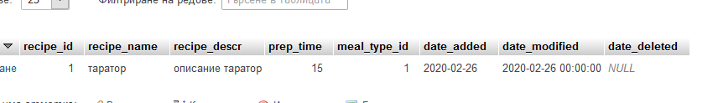
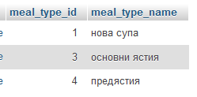
JOINs - example
Recipes have meal_type
meal_type_id is FK in recipes table - points to meal_types table
How to replace the meal_type_id with meal_type_name?
SELECT * FROM `recipes`

Slide 6
JOINs types

Slide 7
JOINs - types
types
INNER JOIN or
JOIN: Returns all rows when there is at least one match in BOTH tables
LEFT JOIN: Return all rows from the left table, and the matched rows from the right table
RIGHT JOIN: Return all rows from the right table, and the matched rows from the left table
FULL JOIN: Return all rows when there is a match in ONE of the tables

Slide 8
JOIN / INNER JOIN

Slide 9
JOIN/INNER JOIN
the sql query
SELECT column_name(s)
FROM table1
INNER JOIN table2
ON table1.column_name=table2.column_name;
or
SELECT column_name(s)
FROM table1
JOIN table2
ON table1.column_name=table2.column_name;

Slide 10
JOIN/INNER JOIN - result
result
Като резултат виждаме само записите, за които има
PK - FK
съответствие.

Slide 11
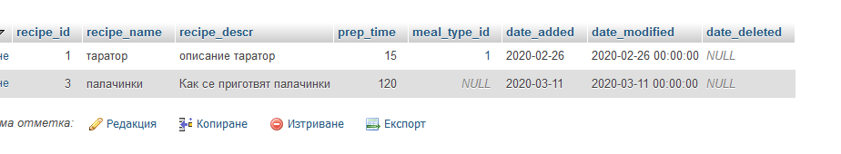
JOIN/INNER JOIN - example
recipes table
*set meal_type_id default value to NULL

Slide 12
JOIN/INNER JOIN
the sql query
the result
SELECT *
FROM `recipes`
JOIN meal_types on recipes.meal_type_id = meal_types.meal_type_id

Slide 13
JOIN/INNER JOIN - tasks
tasks
Направете JOIN заявка към таблиците recipes & meal_types в phpMyAdmin
Селектирайте всички данни
Селектирайте само
името на рецептата и тип ястие
името на рецептата, тип ястие, време за приготвяне
име на рецептата, тип ястие, описание на рецептата
*Приложете в sql заявката си, съкратен запис на името на таблиците.

Slide 14
LEFT JOIN

Slide 15
LEFT JOIN
the sql query
SELECT column_name(s) FROM table1 LEFT JOIN table2 ON table1.column_name=table2.column_name;
or
SELECT column_name(s) FROM table1 LEFT OUTER JOIN table2 ON table1.column_name=table2.column_name;

Slide 16
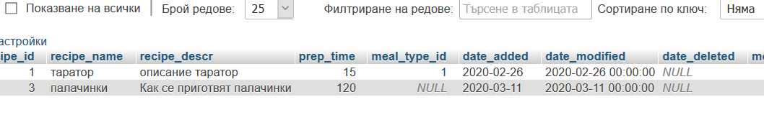
JOIN/INNER JOIN
the sql query - join recipes to meal-types
the result
SELECT * FROM `recipes`
LEFT JOIN meal_types ON recipes.meal_type_id = meal_types.meal_type_id

Slide 17
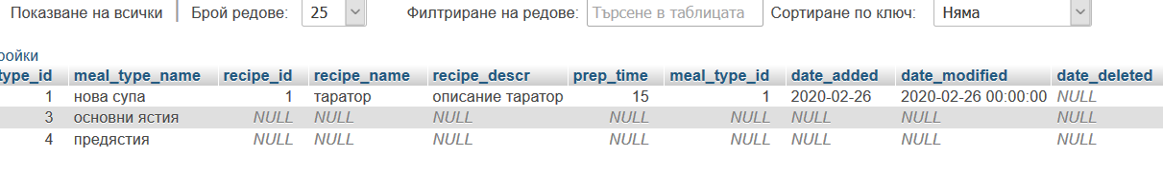
JOIN/INNER JOIN
the sql query - join meal-types to recipes
the result
SELECT * FROM `meal_types`
LEFT JOIN recipes ON meal_types.meal_type_id = recipes.meal_type_id

Slide 18
JOIN/INNER JOIN
Explain the difference between the two queries and their results!

Slide 19
RIGHT JOIN

Slide 20
RIGHT JOIN
the sql query
SELECT column_name(s) FROM table1 RIGHT JOIN table2 ON table1.column_name=table2.column_name;

Slide 21
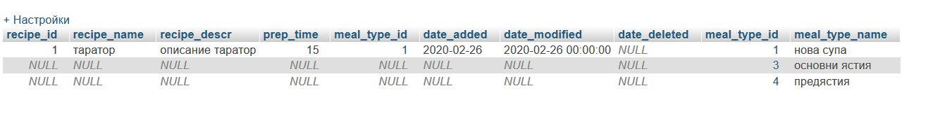
RIGHT JOIN
the sql query - join recipes to meal-types
the result
SELECT * FROM `recipes`
RIGHT JOIN meal_types ON recipes.meal_type_id = meal_types.meal_type_id

Slide 22
RIGHT JOIN
Explain the results of the query - joining meal_types to recipes using
LEFT JOIN
RIGHT JOIN

Slide 23
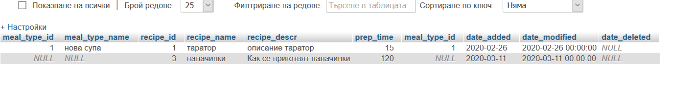
RIGHT JOIN
the sql query - join meal-types to recipes
the result
SELECT * FROM `meal_types`
RIGHT JOIN recipes ON meal_types.meal_type_id = recipes.meal_type_id

Slide 24
RIGHT JOIN
Explain the results of the query - joining recipes to meal_types using
LEFT JOIN
RIGHT JOIN

Slide 25
TIPS & TRICKS

Slide 26
TIPS AND TRICKS
tasks
Add date_added, date_modified, date_deleted columns to meal_types table.
Select all recipes joining meal_types. What happens to the same column data?
Select recipes where meal_types column date_deleted is not NULL.

Slide 27
REMEMBER
First is the result you have the get, then you select the join to use!
*true for every query you set
You can join as many tables as you need if you are able to manage to get the desired and trustworthy result!
When you join tables with same column names, you have to give a unique name for each of them in the SQL query!

Slide 30



Trainings @ Vratsa Software
Vratsa Software – High-Quality Education, Profession and Jobs
www.vratsasoftware.com
The Nest Coworking
www.nest.bg
Vratsa Software @ Facebook
www.fb.com/VratsaSoftware
Slack Channel
www.vso.slack.com

